Slide 1
M.SUSMITHA
Final Project

Slide 2

KEY LOGGER and SECURITY

Slide 3
AGENDA
Introduction
Problem Statement
Problem Overview
Who are the End users?
Your Solution and its Value Proposition
The Wow in your solution
Modelling
Result

Slide 4
INTRODUCTION
What is KEYLOGGER?
A computer program that records every Keystroke made by a computer user, especially
to gain fraudulent access to passwords and other confidential information.

Slide 5
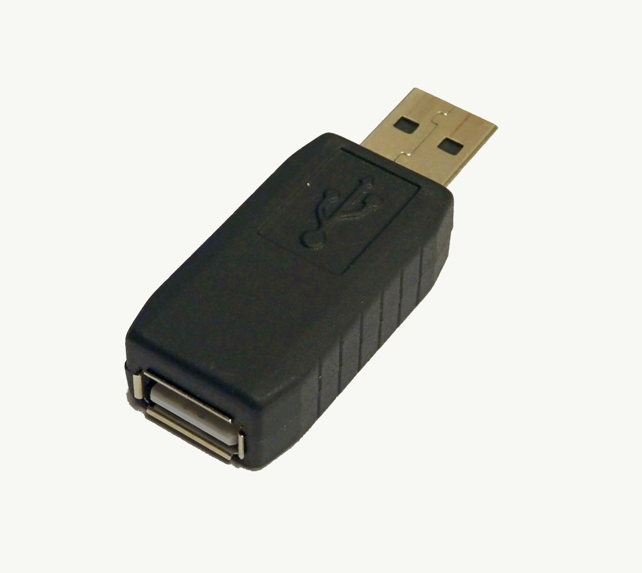
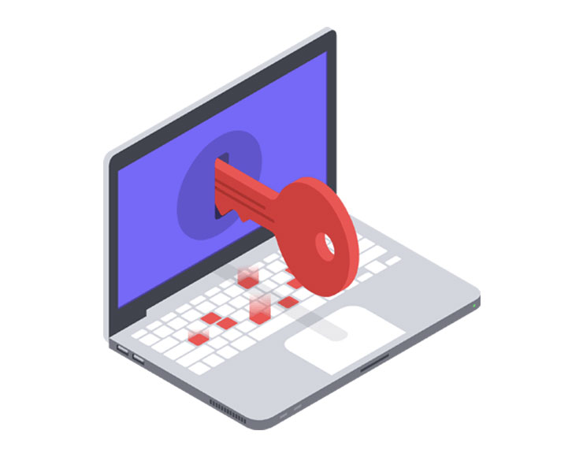
Types of Keyloggers and How They Work:
There are two types of keyloggers: Hardware keyloggers and software keyloggers.
HARDWARE KEYLOGGER:
Hardware keyloggers are physical devices that record every keystroke. Cybercriminals can disguise them in the computer cabling or a USB adapter, making it hard for the victim to detect. However, because you need physical access to the device to install a hardware keylogger, it isn’t as commonly used in cyberattacks.
SOFTWARE KEYLOGGER:
Software keyloggers don’t require physical access to a device. Instead, users download software keyloggers onto the device. A user might download a software keylogger intentionally or inadvertently along with malware

Slide 6

Problem statement
The problem statement is that the keyloggers can be detected using antiviruses. Installation of hardware keyloggers is difficult without the knowledge of the owner of the system. The solution to the above existing problem is that we can build a software keyloggers instead of hardware keyloggers.

Slide 7

PROJECT OVERVIEW
Keylogger is a software that records each and every keystroke you enter, including mouse clicks.
Hardware keyloggers are also available which will be inserted between keyboard and
CPU.
A form of malware or hardware that keeps track of and records your keystrokes as you type
The best way to protect your devices from keylogging is to use a high-quality antivirus or firewall.

Slide 8
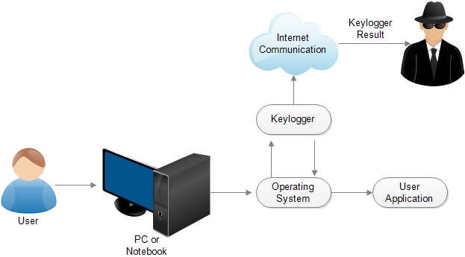
WHO ARE THE END USERS?
**Keyloggers are used in IT organizations to troubleshoot technical problems with computers and business networks. Families and businesspeople use keyloggers legally to monitor network usage
without their users' direct knowledge.
**Ethical hackers and security professionals use keyloggers to identify vulnerabilities in computer systems and networks.
**Parental Control: Parents may use keyloggers to monitor their children's online activities and ensure their safety

Slide 9
YOUR SOLUTION AND ITS VALUE PROPOSITION
you notice a lot of data being sent to unfamiliar destinations, it could indicate the presence of a keylogger. Unusual Network Activity: Monitor your network activity using your device’s built-in network monitoring tools or third-party software.
Change Passwords: Regularly change your passwords for sensitive accounts, especially if you suspect a keylogger. Use two-factor authentication whenever possible to add an extra layer of security.
Antivirus and Anti-malware Scans: Run a full system scan using reputable antivirus and anti-malware software. These tools can detect and remove many types of keyloggers and other malware.
Review Installed Programs/Apps: Check the list of installed programs or applications on your device.

Slide 10

WOW IN YOUR SOLUTION
Full Transparency.
Less Risk of Data Theft
Clearer Protection Against Liability
Better Password Access.
More Productivity.
Tougher Deterrent Against Phishing & Viruses.

Slide 11
MODELLING
Before we start, we need to install Python and some libraries of Python in the system which can be installed by the commands in the command prompt(cmd).
pip install pynput
pip install jsons
Pynput helps in reading keystrokes as the user types in stuff Jsons is a later changing format that often exchanges data between a web server and user agent
* Initialization of keylogger : Set up the main GUI window. Initialize global variables for keylogging.
* Data Logging into text files : Continuously update text and JSON log files with captured key events.
* Stop Logging : Stop capturing key events when the "Stop" button is pressed. Update the GUI status to indicate that the keylogger is stopped.

Slide 12
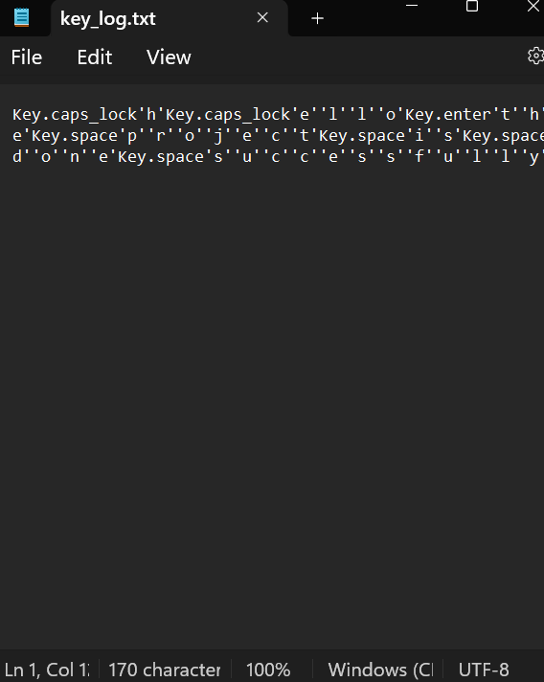
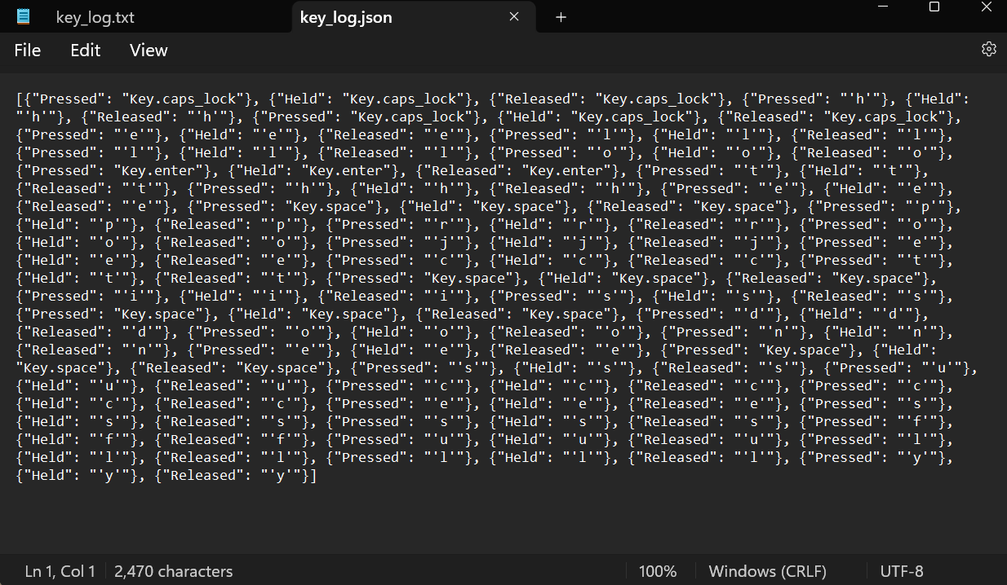
Outputs
Keylogger .txt
Keylogger.json

Slide 13

RESULT
As a result, when a key is pressed, Python will create a keylog.txt file with the list of keys pressed from when the script began running up to the last key pressed.
If we leave the code like that, it will keep executing constantly. We will define a function consisting of some stop key or a combination of keys that will stop the key logger
Real-time keylogging with start and stop functionality controlled via a simple GUI.

Slide 14
PROJECT LINK
Git link:
https://github.com/marellasusmitha/Key-project.git

